Slide 1
About Me
Ritesh Singh
Sun Certified java Professional
Oracle Certified Database Administrator
Certified Ethical Hacker
Certified EC-Council Instructor (CEI)

Slide 2
Course Overview
What is MySQL ?
Install MySQL

Slide 3
What is MySQL
MySQL? What?
My is the daughter’s name of the MySQL’s co-founder, Monty Widenius.
The name of MySQL is the combination of My and SQL, MySQL.
MySQL is a database management system that allows you to manage relational databases. It is open source software backed by Oracle. It means you can use MySQL without paying a dime. Also, if you want, you can change its source code to suit your needs

Slide 4
Even though MySQL is open source software, you can buy a commercial license version from Oracle to get premium support services.
MySQL is pretty easy to master in comparison with other database software like Oracle Database, or Microsoft SQL Server.
MySQL can run on various platforms UNIX, Linux, Windows, etc. You can install it on a server or even in a desktop. Besides, MySQL is reliable, scalable, and fast.

Slide 5
The official way to pronounce MySQL is My Ess Que Ell, not My Sequel. However, you can pronounce it whatever you like, who cares?
If you develop websites or web applications, MySQL is a good choice. MySQL is an essential component of the LAMP stack, which includes Linux, Apache, MySQL, and PHP.

Slide 6
Install MySQL
if you use other operating system platforms such as Linux and macOS, you use the following tutorial:
Install MySQL 8 on CentOS 7
Install MySQL 8 on Ubuntu

Slide 7
Download MySQL Installer
If you want to install MySQL on the Windows environment, using MySQL installer is the easiest way. MySQL installer provides you with an easy-to-use wizard that helps you to install MySQL with the following components:
MySQL Server
All Available Connectors
MySQL Workbench with Sample Data Models
MySQL Notifier
Tools for Excel and Microsoft Visual Studio
MySQL Sample Databases
MySQL Documentation

Slide 8
To download MySQL installer, go to the following link http://dev.mysql.com/downloads/installer/. There are two installer files:
If you are connecting to the internet while installing MySQL, you can choose the online installation version mysql-installer-web-community-<version>.exe .
In case you want to install MySQL offline, you can download the mysql-installer-community-<version>.exe file.

Slide 9
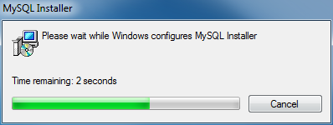
To install MySQL via MySQL Installer
install MySQL using the MySQL installer, double-click on the MySQL installer file and follow the steps below:

Slide 10
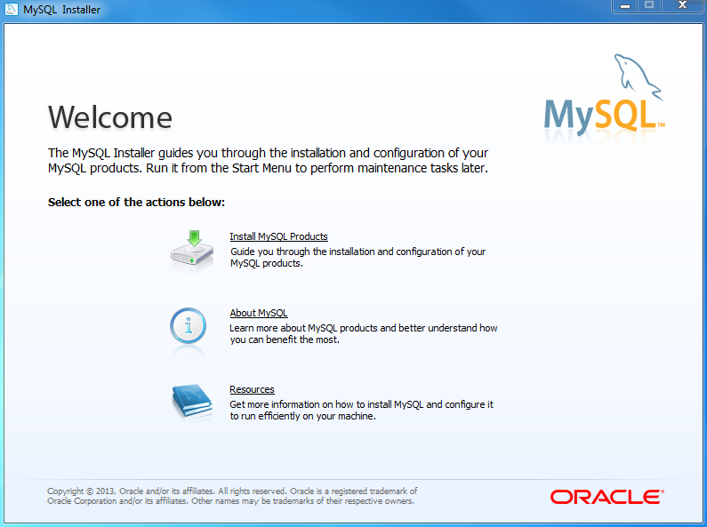
Install MySQL Step 1: Windows configures MySQL Installer

Slide 11
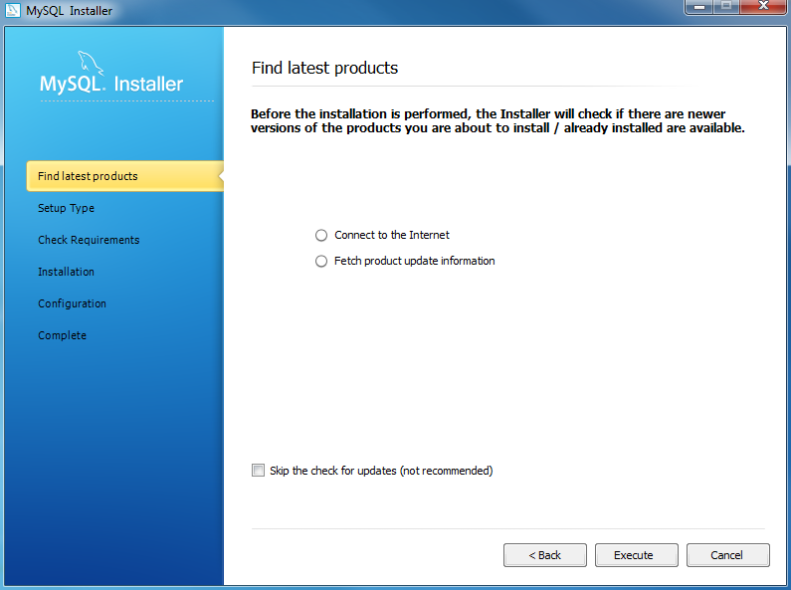
Install MySQL Step 2 – Welcome Screen: A welcome screen provides several options. Choose the first option: Install MySQL Products

Slide 12
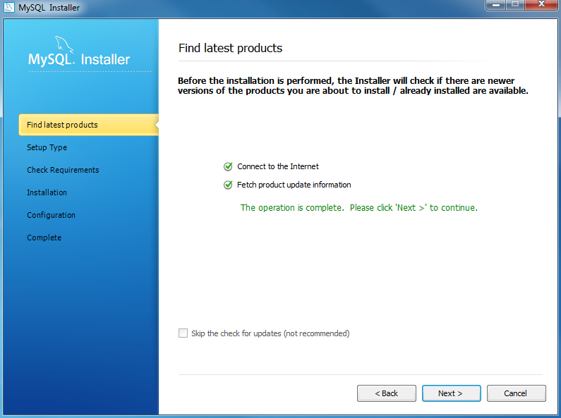
Install MySQL Step 3 – Download the latest MySQL products: MySQL installer checks and downloads the latest MySQL products including MySQL server, MySQL Workbench, etc.

Slide 13
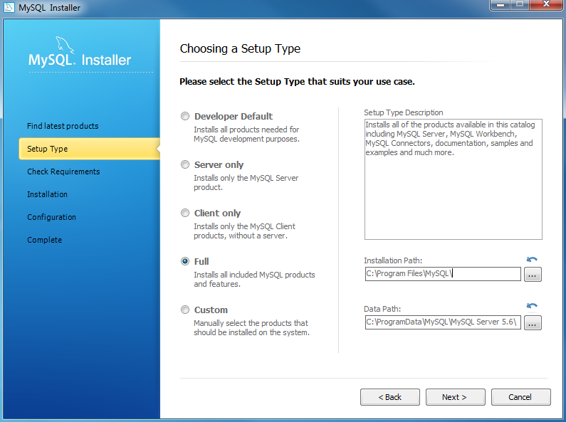
Install MySQL Step 4: Click the Next button to continue

Slide 14
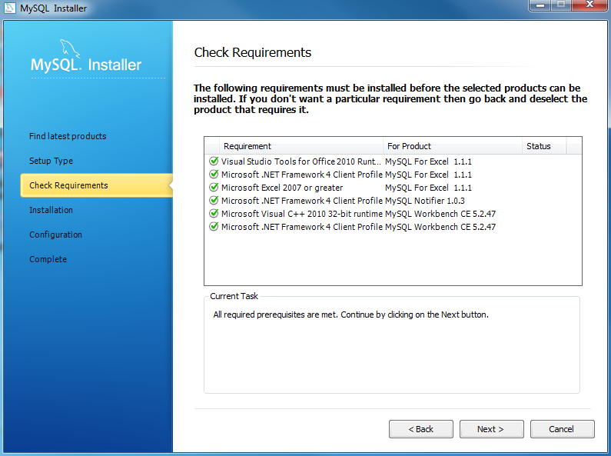
Install MySQL Step 5 – Choosing a Setup Type: there are several setup types available. Choose the Full option to install all MySQL products and features.

Slide 15
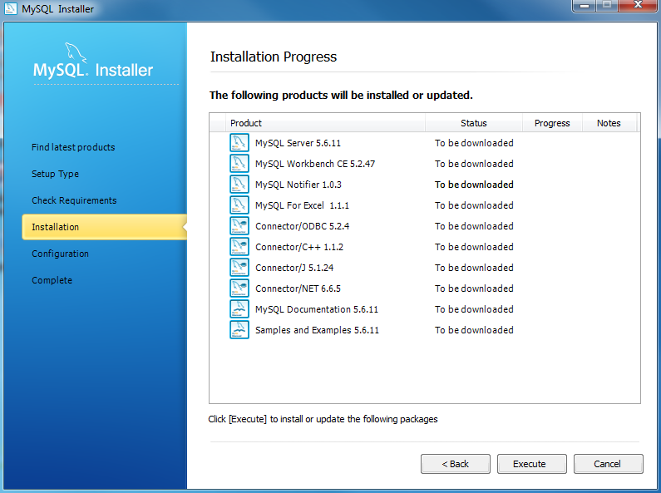
Install MySQL Step 6 – Checking Requirements

Slide 16
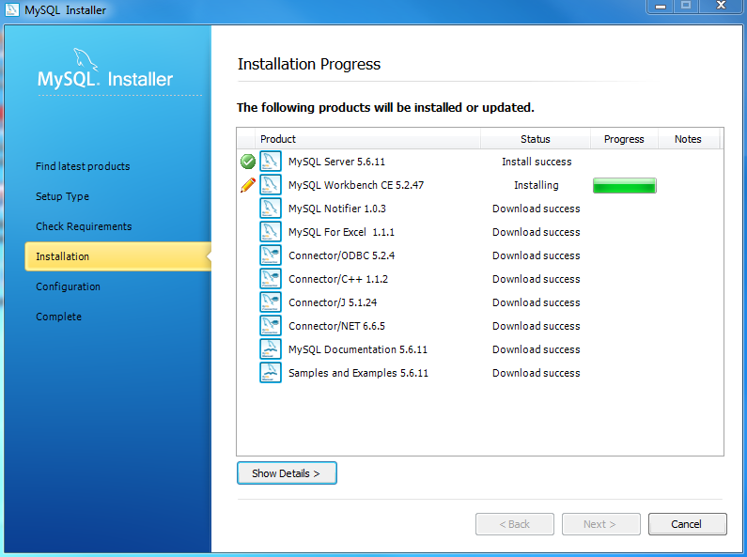
Install MySQL Step 7 – Installation Progress: MySQL Installer downloads all selected products. It will take a while, depending on which products you selected and the speed of your internet connection

Slide 17
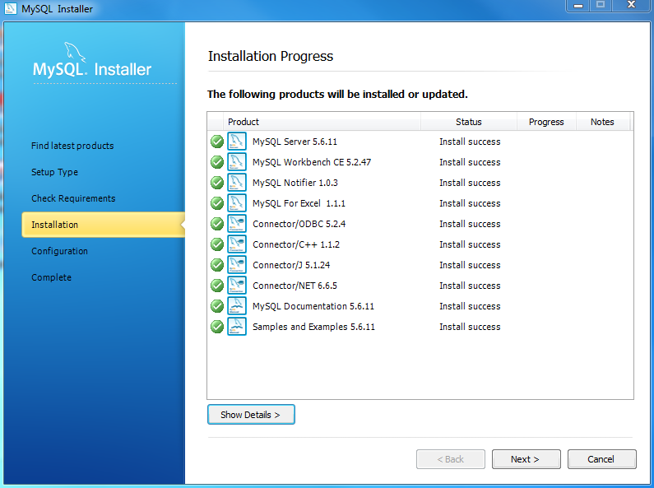
Install MySQL Step 7 – Installation Progress: downloading Products in progress.

Slide 18
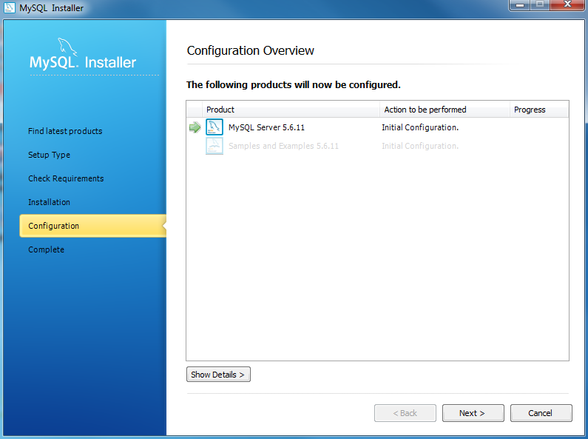
Install MySQL Step 7 – Installation Progress: Complete Downloading. Click the Next button to continue…

Slide 19
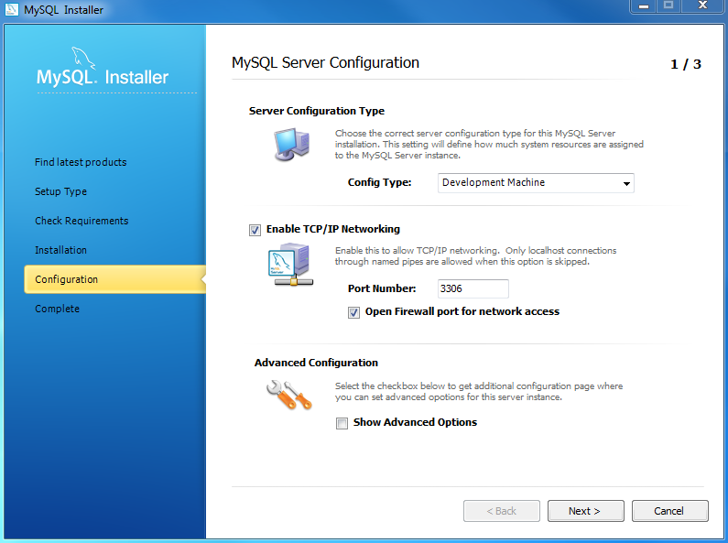
Install MySQL Step 8 – Configuration Overview. Click the Next button to configure MySQL Database Server

Slide 20
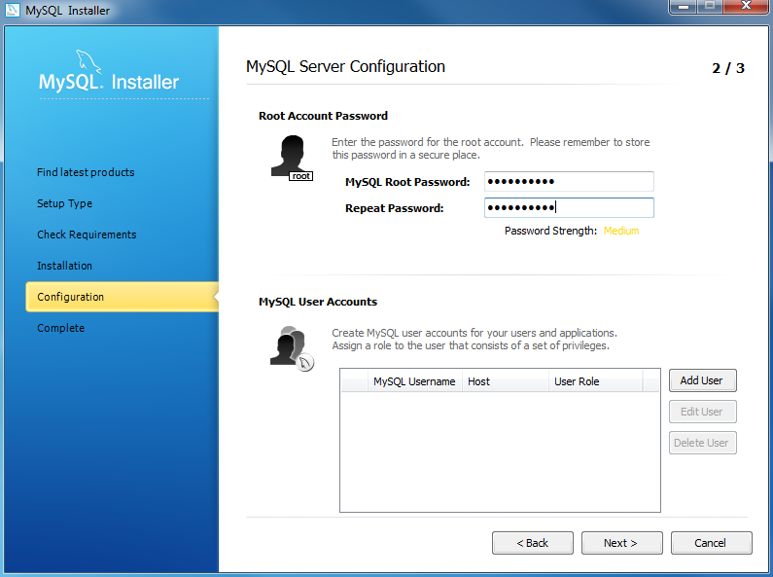
Install MySQL Step 8.1 – MySQL Server Configuration: choose Config Type and MySQL port (3006 by default) and click Next button to continue.

Slide 21
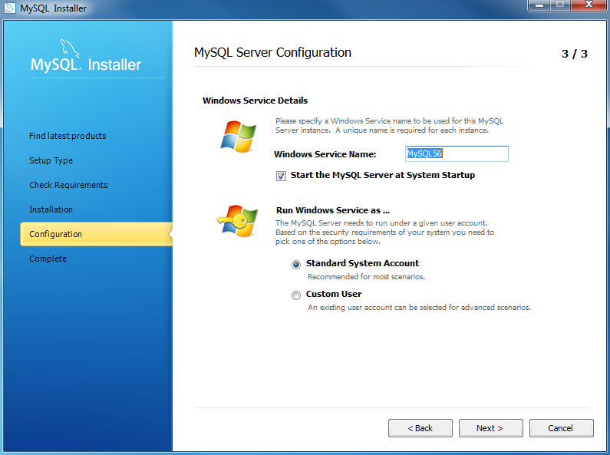
Install MySQL Step 8.1 – MySQL Server Configuration: choose a password for the root account. Please note the password download and keep it securely if you are installing MySQL database server on a production server. If you want to add a more MySQL user, you can do it in this step.

Slide 22
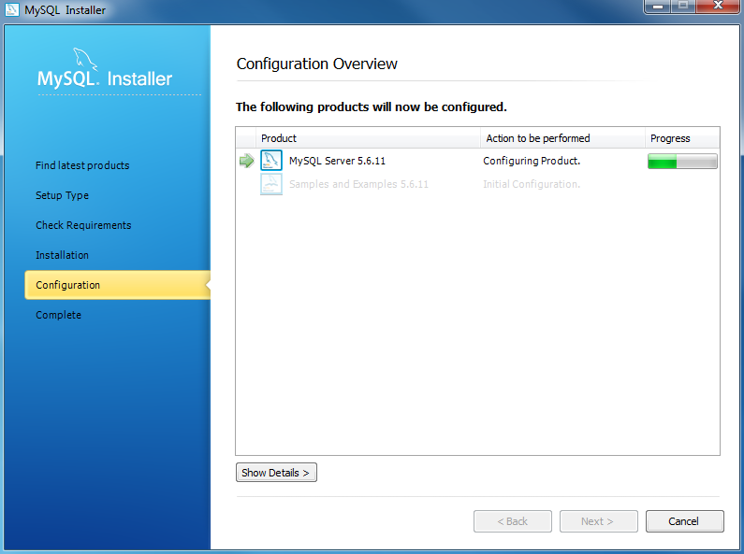
Install MySQL Step 8.1 – MySQL Server Configuration: choose Windows service details including Windows Service Name and account type, then click Next button to continue.

Slide 23
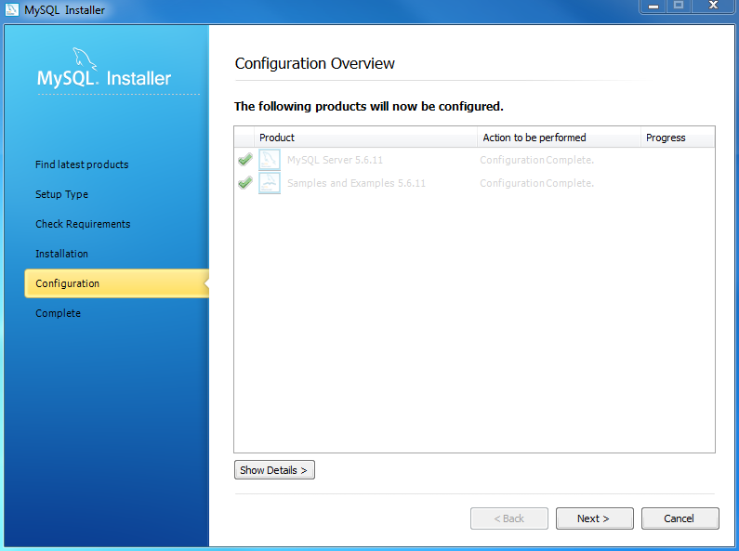
Install MySQL Step 8.1 – MySQL Server Configuration – In Progress: MySQL Installer is configuring MySQL database server. Wait until it is done and click the Next button to continue.

Slide 24

Install MySQL Step 8.1 – MySQL Server Configuration – Done. Click the Next button to continue.

Slide 25
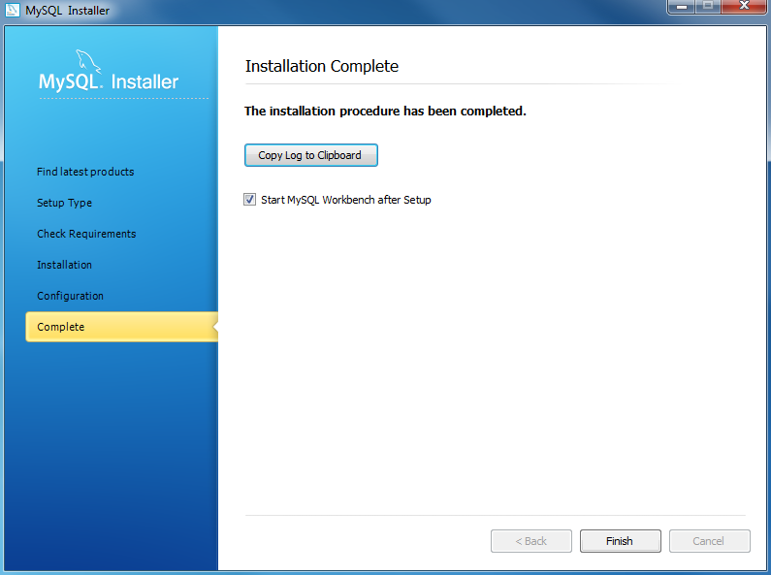
Install MySQL Step 8.2 – Configuration Overview: MySQL Installer installs sample databases and sample models.

Slide 26
Install MySQL Step 9 – Installation Completes: the installation completes. Click the Finish button to close the installation wizard and launch the MySQL Workbench.

Slide 27
Thank You
Please Subscribe My Channel
https://www.youtube.com/channel/UCYW3PWPOPn3qgxxjhUbXXXg?view_as=subscriber

